Slide 1
Facing Scalability Issues in Requirements Prioritization with Machine Learning Techniques
Paper by Paolo Avesani, Cinzia Bazzanella, Anna Perini, and Angelo Susi

Slide 2
Overview
What’s the big deal?
Introduction
Goal
Framework
Conclusion

Slide 3
What’s The Big Deal?
Big Project: Facebook – Messages, Profile, Pictures, Games, Etc
Iterative development looks like, “We need X this next sprint.” Where X is generally huge.
This sprints will generally have many subsystems that need to also be planned.
What other big plan features can these systems derive into? How can we optimize development?
Small Project: Luncherizer – User input, Spin the wheel
These sprints will generally be a subsystem in itself, so we don’t need to derive it further.
Scalability… The bigger the problem, the exponentially harder it is to elicit requirements.

Slide 4
Introduction
First Principle Method – Rank all individual features based on priority
Commonly used, but is prone to error such as partial releases.
Ex-post – Pairwise comparison to decide which requirement has priority
Lots and lots of comparisons
Analytical Hierarchy Process
Ranks all possible pairs of requirements (from ex-post method). O(n^2) – (((n^2)-n)/2)
Assesses these groups to decide relative priority.

Slide 5
Goal
Use machine learning techniques to reduce the amount of pairs gained from the AHP.
But wait? Won’t that reduce effectiveness and create gaps?
No… That is what the machine learning is for, it should only remove useless pairs.
Common strategies reduce the amount of pairs by human elicitation.
This can be time consuming and expensive (and prone to error).
A machine can remove these unwanted pairs with limited effort.

Slide 6
Framework
Interweave manual elicitation with first steps of machine learning.
Pair sampling: Autonomous
Automatic procedure which samples pairs of requirements on the basis of a selection policy.
Selection policy will take into account currently available rankings.
(Loops)Preference elicitation: Stakeholder input
The stakeholders compare pairs of requirements with the option of equality.
(Loops)Ranking Learning: Autonomous
Uses stakeholder input to determine comparison results for unknown pairs.
Considers other criteria such as cost of the requirement, estimated value, etc.

Slide 7
Framework
When user gets tired, they halt the program and the most recent ranking order is returned.
AKA, the user is doing a fraction of the work but still able to help determine the results.
The user will never see the same pair twice.

Slide 8
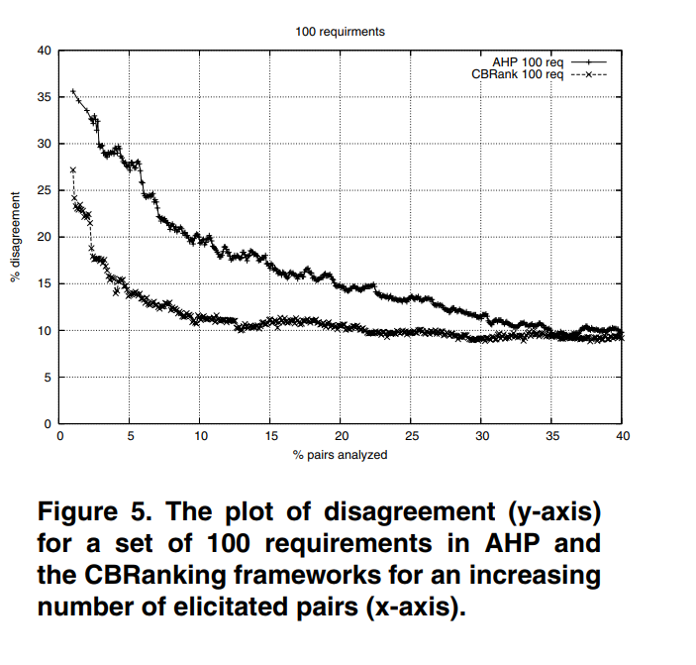
Conclusion
Authors approach outperforms the analytical hierarchy process with respect to the trade-off between expert elicitation effort and the requirement prioritization accuracy.

